Slide 1

How do Organisms
Reproduce?
Modes of reproduction used by single organisms (Binary and Multiple Fission)

Slide 2




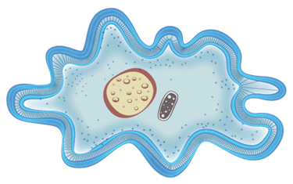


Asexual
Sexual
Only one parent involved
Two parents involved
Simple and small organism like microorganisms
Human, Dogs, Elephants, Birds, Plants

Slide 3
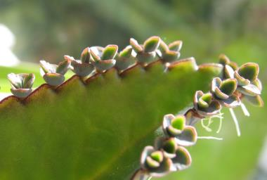
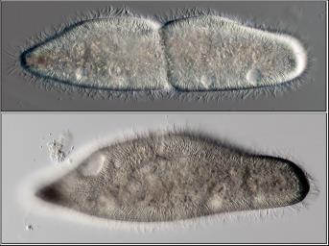
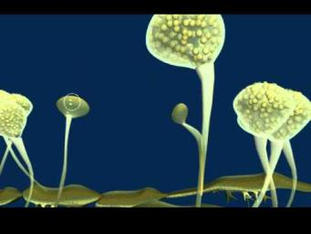
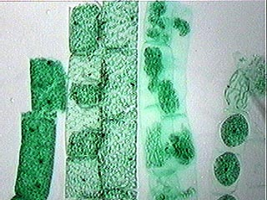
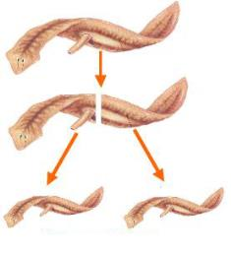
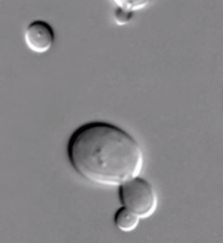
MODES OF REPRODUCTION USED BY SINGLE
ORGANISMS (Asexual Reproduction)
Fission
Fragmentation
Regeneration
Budding
Vegetative Propagation
Spore formation

Slide 4
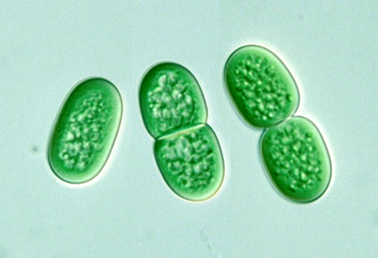
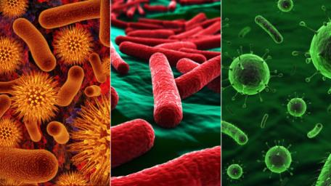
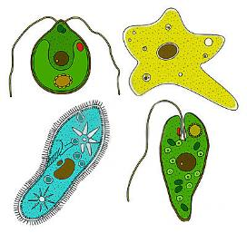
Fission
BINARY FISSION
The living cell
divides into
two equal or nearly equal parts
Two
Division
Seen in
Most of the prokaryotes like bacteria
Some protozoa
For example amoeba
In amoeba binary fission occurs through any plane
Hence it is called simple binary fission.

Slide 5
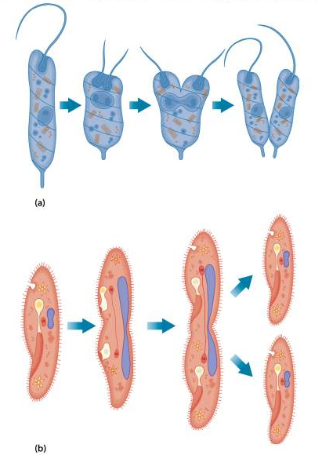
In case of paramoecoum binary fission occurs through transverse section.
Horizontal
Hence it is called transverse binary fission.

Slide 6
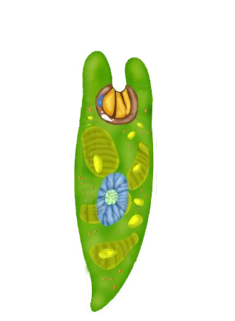
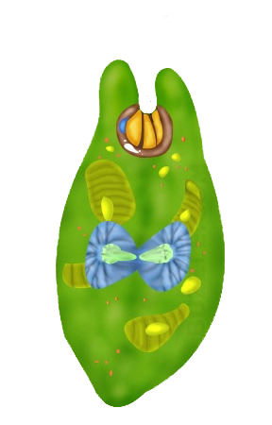
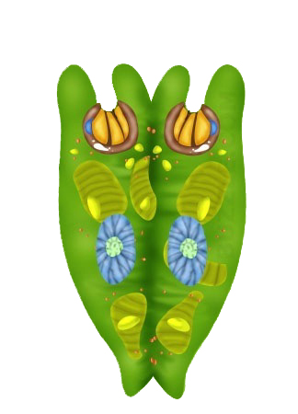
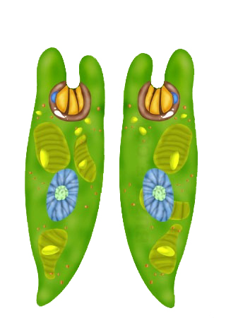
In case of euglena or Leishmania binary fission occurs through longitudinal section.
Vertical
Hence it is called longitudinal binary fission.

Slide 7
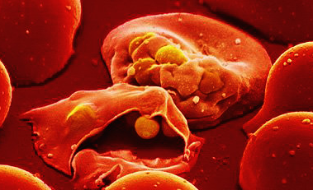
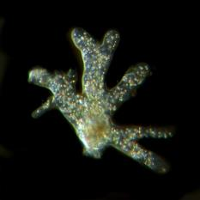
MULTIPLE FISSION
Seen in plasmodium, amoeba.
It occurs during unfavourable conditions.
Amoeba becomes almost round Secretes a hard covering called cyst.
Inside the nucleus divides into many nuclei followed by division of cytoplasm.
As a result many daughter cells are formed.
During favourable conditions the cyst bursts releasing daughter cells.
cyst

Slide 8
Thank You

